Slide 1


Python Programming Ⅰ
week 9

Slide 2
Data Pipeline

Slide 3

Pipeline
origin
destination
flow

Slide 4
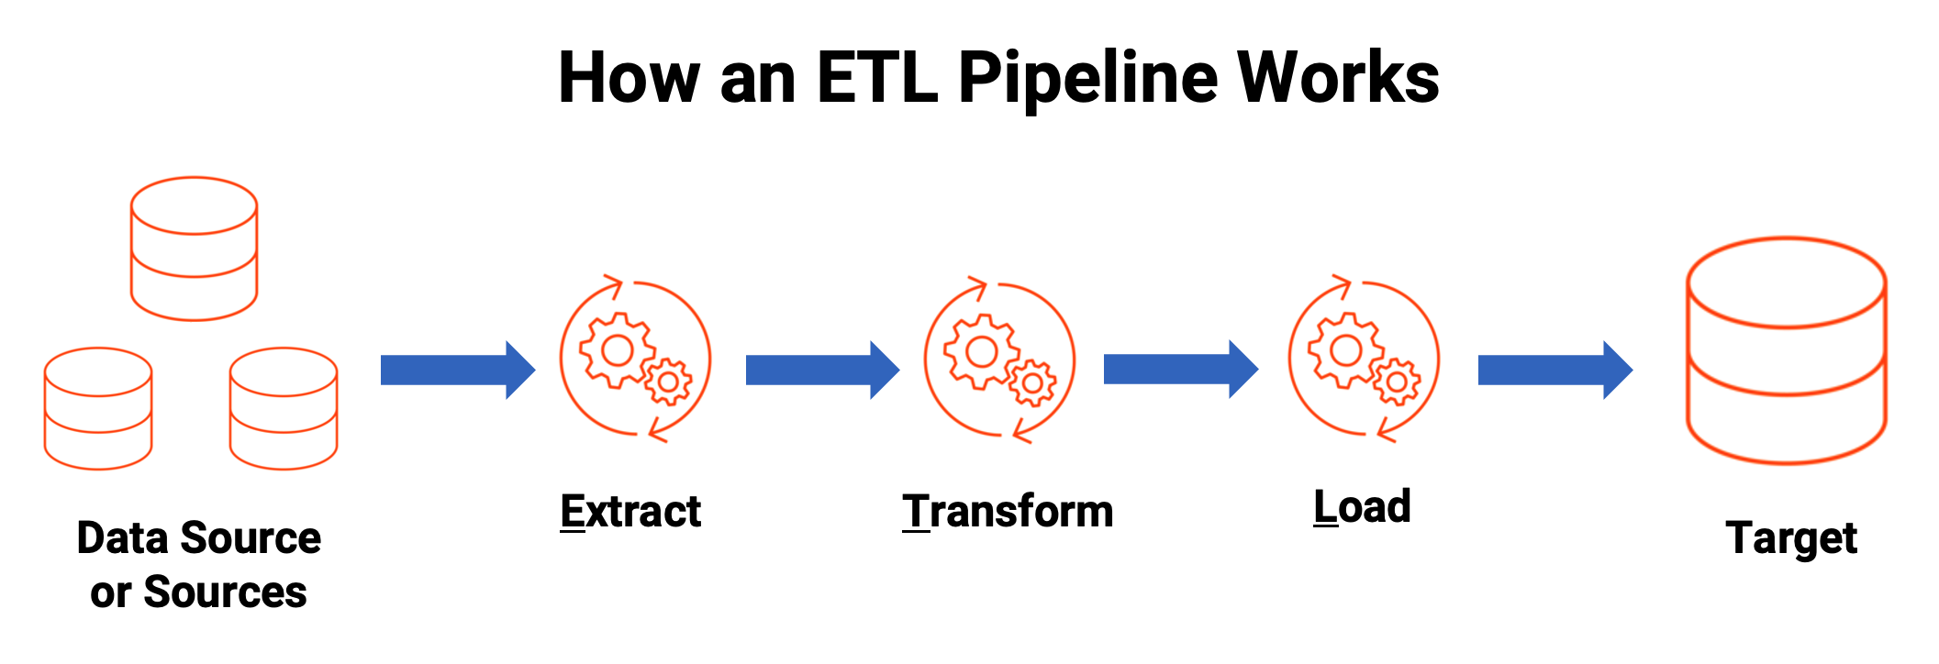
data pipeline
https://www.informatica.com/in/resources/articles/what-is-etl-pipeline.html

Slide 5
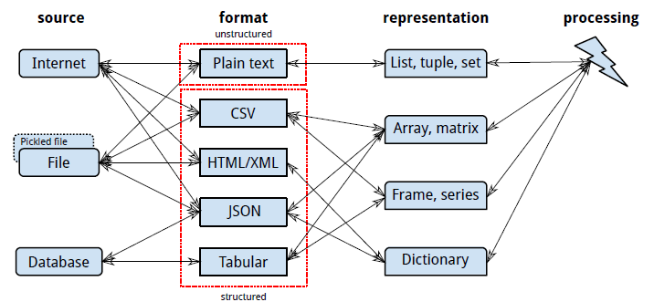
Data Acquisition Pipeline

Slide 6
Tabular Text Files
A separator, or delimiter, character like tab ('\t'), comma (','), or vertical bar('|'). This is an example of the comma-separated values (CSV) format.
'<' and '>' around tags. Examples include XML and HTML.
Punctuation. An example is JavaScript Object Notation (JSON).
Indentation. An example is YAML (which is recursively defined as “YAML Ain’t Markup Language”).

Slide 7
CSV
import csv
villains = [
['Doctor', 'No'],
['Rosa', 'Klebb'],
['Mister', 'Big'],
['Auric', 'Goldfinger'],
['Ernst', 'Blofeld'],
]
# a context manager with open('../img1/villains', 'wt') as fout:
csvout = csv.writer(fout)
csvout.writerows(villains)
with open('../img1/villains', 'rt') as fin:
cin = csv.reader(fin)
villains = [row for row in cin] # a list comprehension
print(villains)
# Proper file path with error handling
try:
# ensure no extra newlines are inserted
with open('../img1/villains.csv', 'w', newline='') as fout:
csvout = csv.writer(fout)
csvout.writerows(villains)
except IOError as e:
print(f"An error occurred while writing the file: {e}")

Slide 8
CSV
import csv
with open('villains', 'rt') as fin:
cin = csv.DictReader(fin,
fieldnames=['first', 'last'])
villains = [row for row in cin]
print(villains)
# Proper file path with error handling
import pandas as pd
df = pd.DataFrame(villains)
print(df)
first last
0 Doctor No
1 Rosa Klebb
2 Mister Big
3 Auric Goldfinger
4 Ernst Blofeld
[{'first': 'Doctor', 'last': 'No'}, {'first': 'Rosa', 'last': 'Klebb'}, {'first': 'Mister', 'last': 'Big'}, {'first': 'Auric', 'last': 'Goldfinger'}, {'first': 'Ernst', 'last': 'Blofeld'}]

Slide 9
XML
Delimited files convey only two dimensions: rows (lines) and columns (fields within a line).
If you want to exchange data structures among programs, you need a way to encode hierarchies, sequences, sets, and other structures as text.
xml_content = '''<?xml version="1.0"?>
<menu>
<breakfast hours="7-11">
<item price="$6.00">breakfast burritos</item>
<item price="$4.00">pancakes</item>
</breakfast>
<lunch hours="11-3">
<item price="$5.00">hamburger</item>
</lunch>
<dinner hours="3-10">
<item price="$8.00">spaghetti</item>
</dinner>
</menu>
'''
# Save the XML content to a file
file_path = '../img1/menu.xml’
try:
with open(file_path, 'w') as file:
file.write(xml_content)
print(f"XML content successfully written to {file_path}")
except IOError as e:
print(f"An error occurred while writing the file: {e}")

Slide 10
XML
XML is often used for data feeds and messages and has subformats like RSS and Atom.
xml_content = '''<?xml version="1.0"?>
<menu>
<breakfast hours="7-11">
<item price="$6.00">breakfast burritos</item>
<item price="$4.00">pancakes</item>
</breakfast>
<lunch hours="11-3">
<item price="$5.00">hamburger</item>
</lunch>
<dinner hours="3-10">
<item price="$8.00">spaghetti</item>
</dinner>
</menu>
'''
import xml.etree.ElementTree as et
tree = et.ElementTree(file='../img1/menu.xml')
root = tree.getroot()
print(root.tag) for child in root:
print('tag:', child.tag, 'attributes:', child.attrib)
for grandchild in child:
print('\ttag:', grandchild.tag, 'attributes:', grandchild.attrib)
print(len(root)) # number of menu sections
print(len(root[0])) # number of breakfast items
print(len(root[1])) # number of lunch items

Slide 11
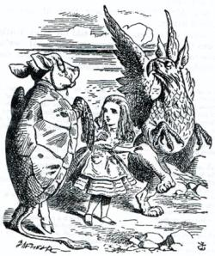
HTML
xml_content = '''<?xml version="1.0"?>
<menu>
<breakfast hours="7-11">
<item price="$6.00">breakfast burritos</item>
<item price="$4.00">pancakes</item>
</breakfast>
<lunch hours="11-3">
<item price="$5.00">hamburger</item>
</lunch>
<dinner hours="3-10">
<item price="$8.00">spaghetti</item>
</dinner>
</menu>
'''
from bs4 import BeautifulSoup
# Write the XML content to an HTML file
with open('../img1/menu.html', 'w') as file:
file.write(xml_content)
# Read the HTML file with BeautifulSoup
with open('../img1/menu.html', 'r') as file:
soup = BeautifulSoup(file, 'html.parser')
# Extract and print out the menu items
for item in soup.find_all('item'):
print(f'{item.text}: {item.get("price")}')
https://www.crummy.com/software/BeautifulSoup/bs4/doc/

Slide 12
JSON
menu = \
{
"breakfast":
{
"hours": "7-11",
"items": {
"breakfast burritos": "$6.00",
"pancakes": "$4.00"
}
},
"lunch" :
{
"hours": "11-3",
"items": {
"hamburger": "$5.00"
}
},
"dinner":
{"hours": "3-10",
"items": {
"spaghetti": "$8.00"
}
}
}
import json
# python dictionary is converted to JSON-formatted string
menu_json = json.dumps(menu)
# output the JSON string to the console
print(menu_json)
# takes the JSON string menu_json and parses it back into a dictionary.
menu2 = json.loads(menu_json)
print(menu2)

Slide 13
YAML
name:
first: James
last: McIntyre
dates:
birth: 1828-05-25
death: 1906-03-31
details:
bearded: true
themes: [cheese, Canada]
books:
url: http://www.gutenberg.org/files/36068/36068-h/36068-h.htm
poems:
- title: 'Motto'
text: |
Politeness, perseverance and pluck,
To their possessor will bring good luck.
- title: 'Canadian Charms'
text: |
Here industry is not in vain,
For we have bounteous crops of grain,
And you behold on every field
Of grass and roots abundant yield,
But after all the greatest charm
Is the snug home upon the farm,
And stone walls now keep cattle warm.
import yaml
with open('../img1/mcintyre.yaml', 'rt') as fin:
text = fin.read()
data = yaml.safe_load(text)
print(data['details'])
print(len(data['poems']))
print(data['poems'][1]['title'])
{'bearded': True, 'themes': ['cheese', 'Canada']}
2
Canadian Charms

Slide 14
with-statement
# Dump an object into a file
with open("myData.pickle", "wb") as oFile:
pickle.dump(object, oFile)
# Load the same object back
with open("myData.pickle", "rb") as iFile:
object = pickle.load(iFile)
https://realpython.com/python-with-statement/#managing-resources-in-python

